Slide 1
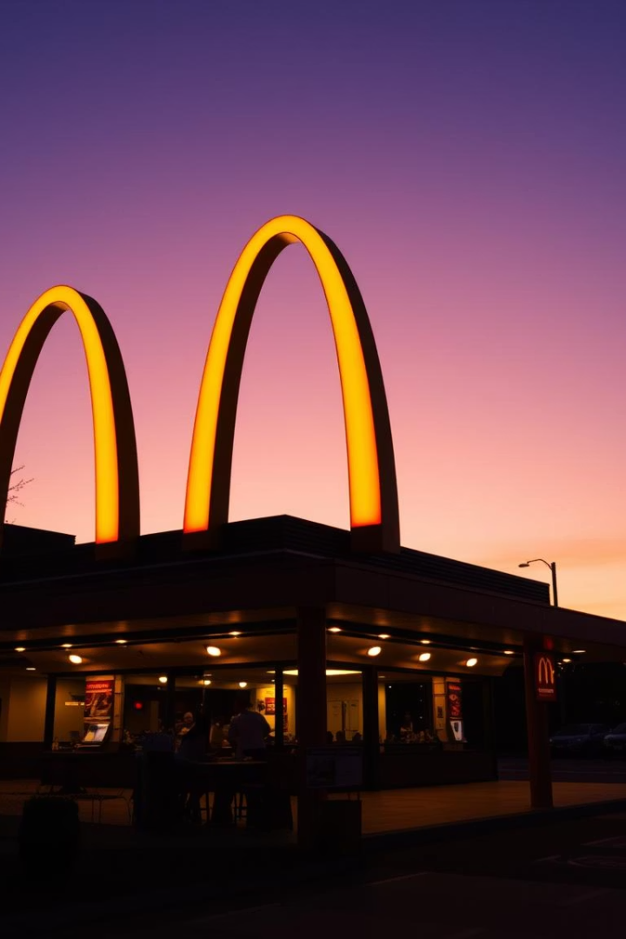

McDonald’s Financial Situation & Business Opportunities (2002–2022)
This presentation analyzes McDonald's financial performance. We will explore key trends. We also identify strategic opportunities.
by suhaila saheen

Slide 2
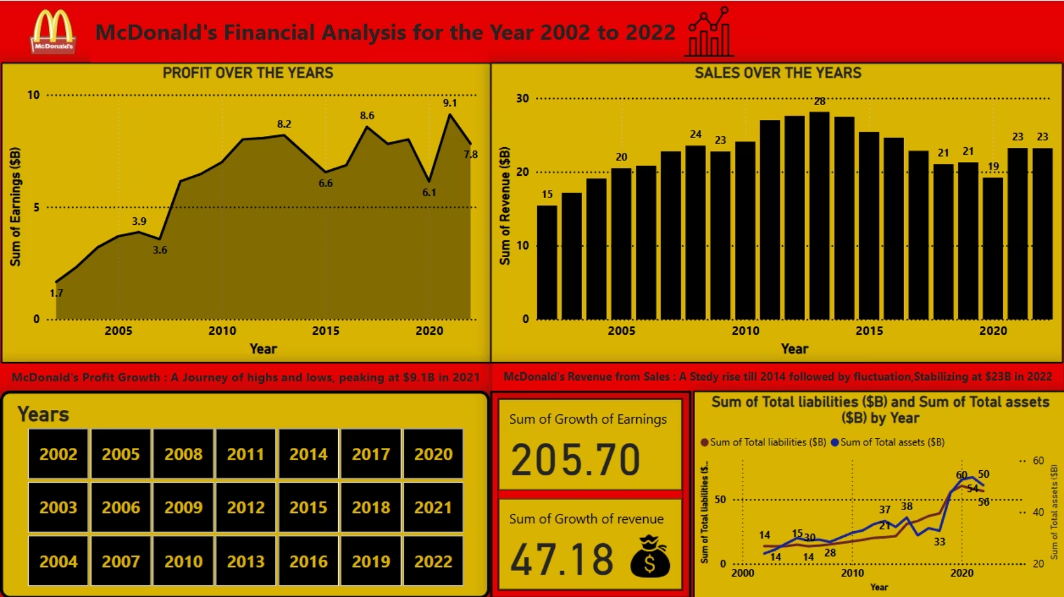

Slide 3
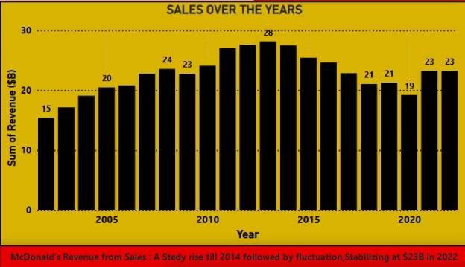
Sales Trend: Consistent but Plateaued
Sales peaked at $28 billion in 2014. They stabilized at $23 billion from 2020 to 2022. This shows a strong customer base. However, growth has slowed significantly.
Opportunities for Growth
Boost digital channels: mobile ordering, delivery, loyalty programs.
Expand in emerging markets with rising fast-food demand.

Slide 4
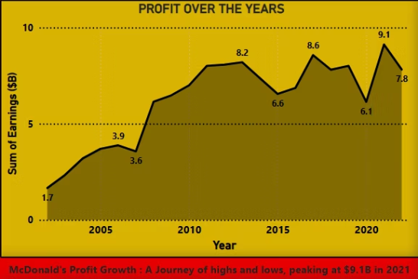
Profit Trend: High Peaks but Volatile
Profit hit a record $9.1B in 2021. It then dipped to $7.8B in 2022. This shows profitability but also sensitivity to market changes. It highlights the need for cost control.
Strategic Profit Enhancement
Improve supply chain efficiency to control costs.
Implement automation and AI for labor savings.

Slide 5
Financial Health: Assets vs. Liabilities
$50B
$56B
Assets
Liabilities
Total assets in 2022.
Total liabilities in 2022.
Since 2008, liabilities have exceeded assets. This high leverage creates risk. Especially with rising interest rates or economic downturns.
Improving Financial Position
Reduce debt gradually to improve financial health.
Adopt an "asset-light" model through increased franchising.

Slide 6
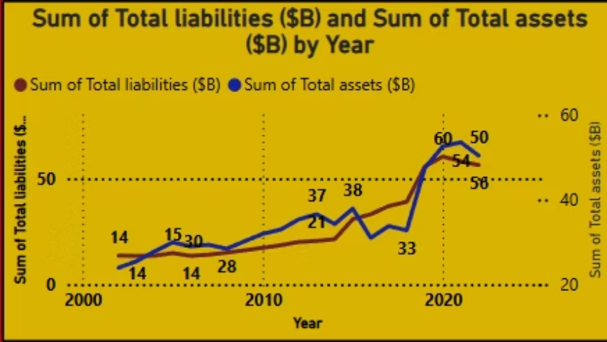

Slide 7



Conclusion: Key Takeaways & Next Steps
Cost Control
Manage expenses for sustainable growth.
Digital Growth
Invest in technology and online presence.
Debt Reduction
Reduce financial exposure for stability.
McDonald's has brand power and sales. However, it faces growth and financial risks. Focusing on these areas ensures future stability and success.

